Slide 1
Patient Vital Signs

Slide 2
4 Major Vitals
Blood Pressure
Regular/Orthostatic
Pulse
Respirations
Sp02

Slide 3
Blood Pressure
the pressure of the blood in the circulatory system, often measured for diagnosis since it is closely related to the force and rate of the heartbeat and the diameter and elasticity of the arterial walls
Systolic
Systolic blood pressure (the upper number) — indicates how much pressure your blood is exerting against your artery walls when the heart beats
Diastolic
Diastolic blood pressure (the lower number) — indicates how much pressure your blood is exerting against your artery walls while the heart is resting between beats.

Slide 4
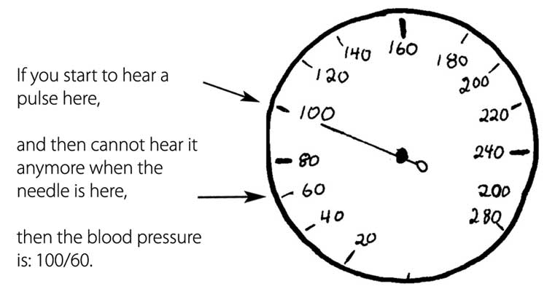
How to take
Locate Left Arm
Closes to heart
Locate Median Cubital Artery
Apply Cuff
Pump Cuff to around 140mm/mg
Check for sound
Start Releasing
First beat is systolic number
Last beat is diastolic

Slide 5
Measurements *AHA standards
Blood Pressure Category | Systolic mm Hg (upper #) |  | Diastolic mm Hg (lower #)
Normal | less than 120 | and | less than 80
Prehypertension | 120 – 139 | or | 80 – 89
High Blood Pressure (Hypertension) Stage 1 | 140 – 159 | or | 90 – 99
High Blood Pressure (Hypertension) Stage 2 | 160 or higher | or | 100 or higher
Hypertensive Crisis (Emergency care needed) | Higher than 180 | or | Higher than 110

Slide 6
Pulse
Related to heart beats
Should be taken for 30 seconds multiplied by 2
If irregular pulse must be counted for 1 full minute
Sites
Radial
Femoral
Brachial
Carotid * Emergency*

Slide 7
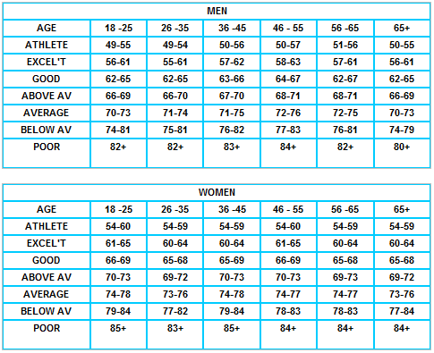
Pulse Values

Slide 8
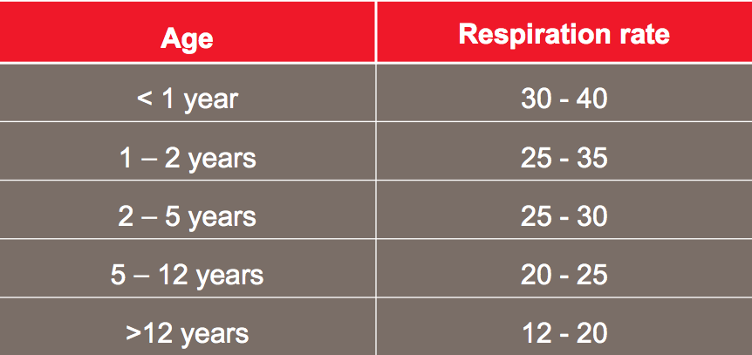
Respirations
Number of breaths
Inhalation and Exhalation
Counted for 30 seconds
Last 30 seconds of pulse check

Slide 9
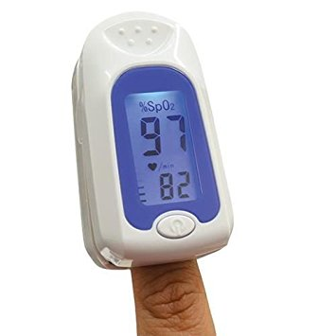
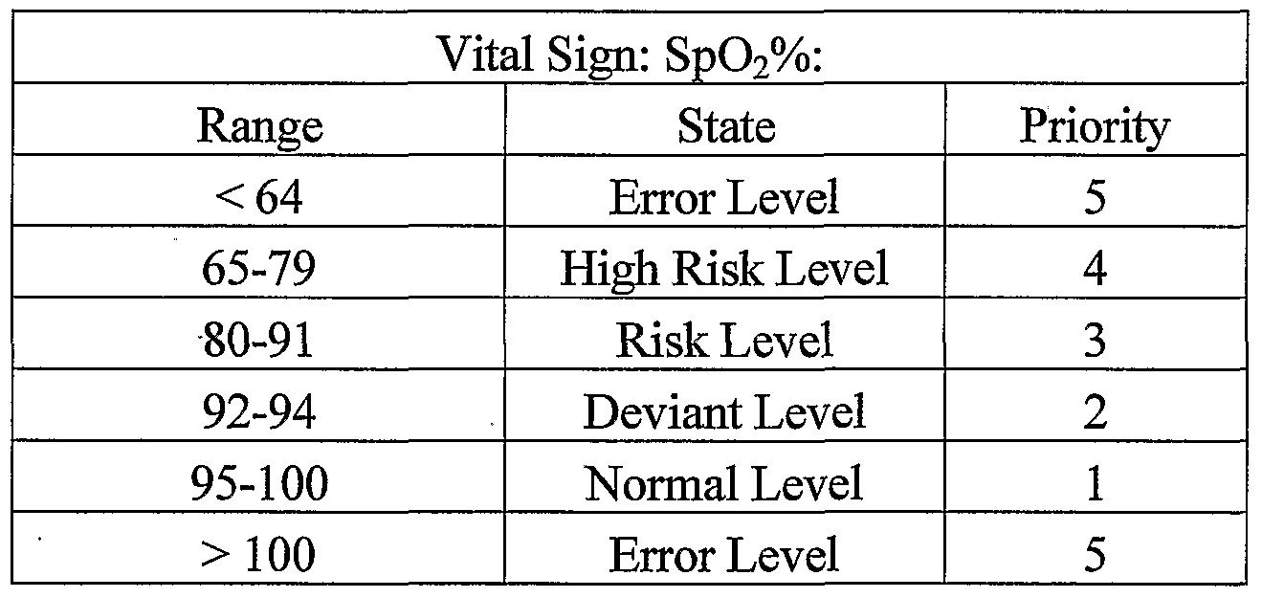
Sp02
Oxygen Saturation of Blood

